Slide 1
Transforming Extended Entity Relationship Models into Relational Database Designs

Slide 2
Transforming Entity Sets and Their Attributes
EMPID
NAME
SALARY
EMPLOYEE
The above ER Model is translated into the following relational design:
EMPLOYEE (empid, name, salary)

Slide 3
Weak Entities (Review)
A WEAK ENTITY is an entity whose existence in the database depends upon the existence of some other entity.
  Example - Insurance companies provide medical coverage to the teachers at Sleepy Valley High and their dependents. So, a dependent can exist in the database only if he/she is associated with a teacher at Sleepy Valley High School.
A weak entity (set) is denoted in an E-R model by rounding the corners of the entity rectangle; the relationship on which the weak entity depends upon for its existence is depicted as a diamond with rounded corners.

Slide 4

EMPLOYEE
1:N
0
DEPENDENT
An Example of a Weak Entity: The DEPENDENT entity is a weak entity, and its existence depends upon a corresponding EMPLOYEE entity.
This illustrates an “Existence Dependent” weak entity set DEPENDENT.

Slide 5
ID-dependent Entities
BUILDING
1:N
0
APARTMENT
An ID-dependent entity (set) is a special type of weak entity, where the (unique) identifier of the weak entity class must be composite and must include the (unique) identifier of the other entity class.
The (unique) identifier of BUILDING would be BuildingName (or BuildingNumber). Would the unique identifier of APARTMENT be ApartmentNumber?

Slide 6
ID-dependent Entities
The identifier of APARTMENT would be the composite identifier (BuildingName, ApartmentNumber).
  So, both logically and physically, an APARTMENT cannot exist unless a BUILDING exists.
Another example of an ID-dependent entity is the entity VERSION in the relationship between PRODUCT and VERSION, where PRODUCT is a software product, and VERSION is a release of that software product.
  Identifier of PRODUCT would be ProductName, and identifier of the ID-dependent entity set VERSION would be (Productname, ReleaseNumber)

Slide 7
Transforming Existence Dependent Weak Entities to a Relational Design
As before, just build a relation having the name of the Existence Dependent Weak Entity Set, with the same attributes, and underline the primary key:
DEPENDENT (SocSecNum, LastName, FirstName, StreetAddress, City, State, etc. )
DEPENDENT
The parent (strong entity set) upon which the weak entity set is existence dependent would also exist in the database. The ‘parent’ in this case is EMPLOYEE. Moreover, a business rule needs to be established, so that if a particular entity in the parent entity class is deleted, then the weak entities in the weak entity set which ’depend’ upon that particular parent must also be deleted.

Slide 8
The “Parent” of the Existence Dependent Weak Entity Set
The parent (strong entity set) upon which the weak entity set is existence dependent would also exist in the database. The ‘parent’ in this case is EMPLOYEE. Moreover, a business rule needs to be established, so that if a particular entity in the parent entity class is deleted, then the weak entities in the weak entity set which ’depend’ upon that particular parent must also be deleted.

Slide 9
Transforming ID-Dependent Weak Entities: Add to the Weak Entity the Primary Key of the Strong Entity Set on Which It Depends, Thereby Creating a Composite Primary Key
INVOICE
1:N
LINE-ITEM
INVOICE( InvoiceNum, Desc,...,Cost)
LINE-ITEM (InvoiceNum, LineNum, Qty, ItemNumber, Description, ExPrice)
results from
INVOICE( InvoiceNum, Desc,...,Cost)
LINE-ITEM (LineNum, Qty, ItemNumber, Description, ExPrice)

Slide 10
Representing a ‘Has-a’ Relationship
1:1 and 1:N relationships are transformed into a relational design by creating foreign keys
A foreign key is when you take the primary key from one table (on the one-side) and place it into another table (on the many-side or into the other table for a 1:1 relationship)

Slide 11
Transforming 1:1 Relationships
EMPLOYEE
1:1
AUTO
EMPLOYEE( EmpNum, Name, Phone, ...)
AUTO( AutoId, Model, Year, Color, ..., EmpNum)
or
EMPLOYEE( EmpNum, Name, Phone,..., AutoID)
AUTO( AutoID, Model, Year, Color,...)
In both cases, we would want to enforce referential integrity by requiring that the value of a foreign key in one relation/table appear as the value of a primary key in the other relation/table.

Slide 12
Representing a 1:1 Relationship
The foreign key can go on either side BUT it is on one side only

Slide 13
Questionable 1:1 Mandatory Relationships
EMPLOYEE
1:1
AUTO
1:1 mandatory relationships should be looked at very closely – sometimes they can be combined into a single relation/table.
However, sometimes it can be justified NOT to combine the two tables in a 1:1 mandatory relationship into a single table.

Slide 14
When NOT to Combine 1:1 Mandatory Relationships
JOB-EVALUATION
EMPLOYEE
1:1
PERFORMANCE (for instance, if Job-Evaluation data are lengthy and used very infrequently)
SECURITY (for instance, if Job-Evaluation data needs to be protected against unauthorized access)

Slide 15
Transforming One to Many Relationships
DORMITORY
1:N
STUDENT
DORMITORY( DormitoryName, Location, NumRooms)
STUDENT( StudentId, StuName, ..., DormitoryName)
Transformation Rule: The primary key of the entity set on the "One" side of the relationship becomes a foreign key of the entity set on the "Many" side of the relationship.

Slide 16
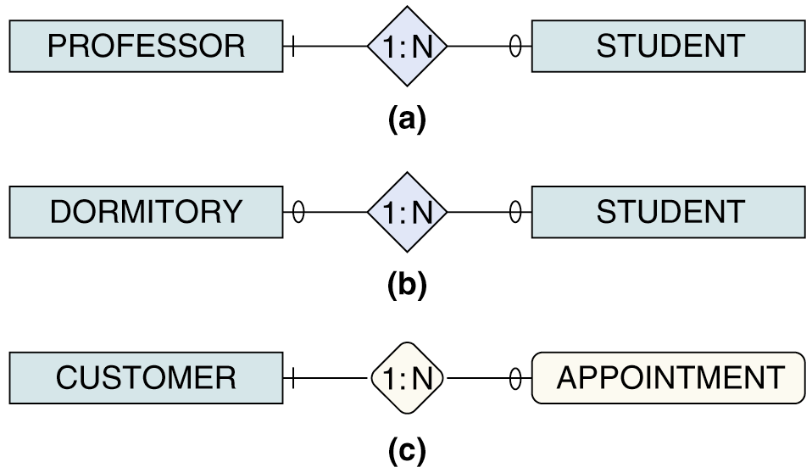
Representing 1:N Relationships
In each of the following examples, the foreign key goes to the table on the right (into the many-side)

Slide 17
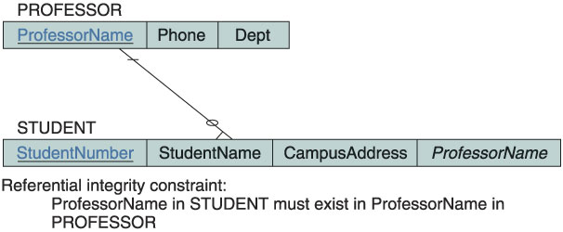
Data Structure Diagrams
ProfessorName goes into the Student table as a Foreign Key
Note that in a DSD, a crow’s foot on a relationship line indicates a many relationship

Slide 18
Transforming Many to Many E-R Relationships
STUDENT
M:N
CLASS
STUDENT( StudentNum, StuName, Phone, ...)
CLASS( ClassNum, ClassName, ...)
STU-CLASS( StudentNum, ClassNum)
RULE: Create a new relation, called an Intersection relation, whose only (***unless there is also an attribute belonging to the relationship***) attributes will be a composite primary key consisting of the primary keys of the entity set participants in the relationship.

Slide 19
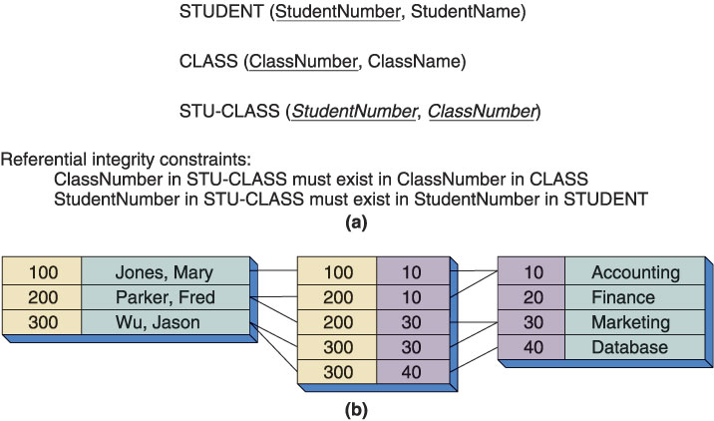
Representing a M:N Relationship

Slide 20
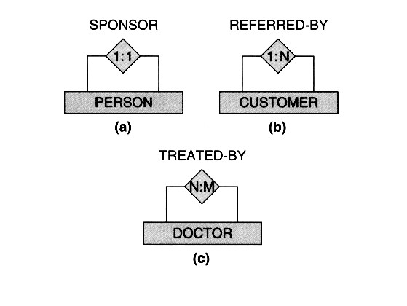
Transforming Recursive (Unary) Relationships Into Relational Designs
There are three types of recursive relationships:
1:1
1:N
N:M

Slide 21
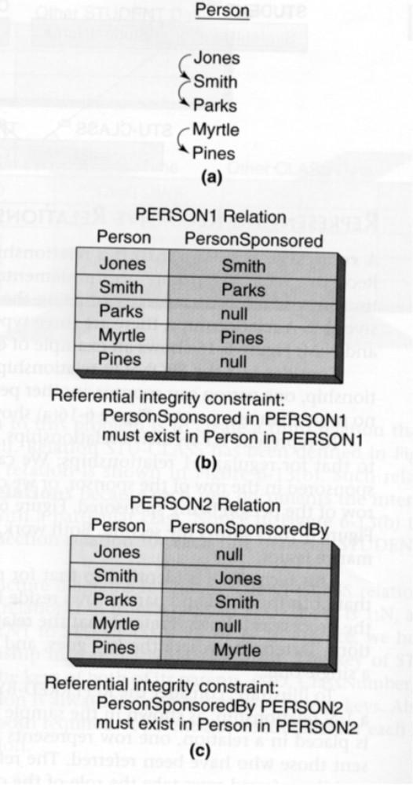
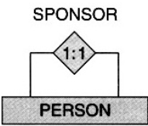
Tranforming a 1:1 Recursive Relationship Into a Relational Design

Slide 22
Transforming Recursive Relationships
Case I: 1 to 1 Recursive relationships
SPONSOR
1:1
PERSON
SPONSOR( Person, PersonSponsored)
or
SPONSOR( Person, PersonSponsoredBy)

Slide 23
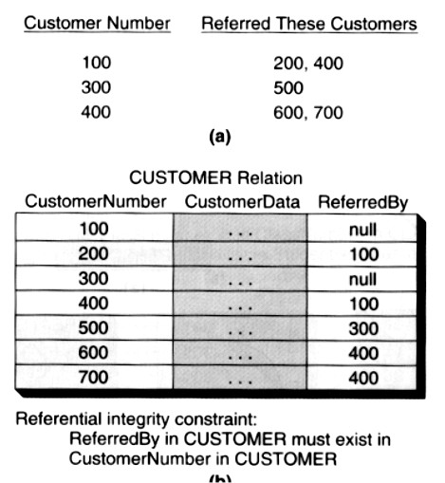
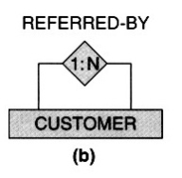
Tranforming a 1:N Recursive Relationship Into a Relational Design

Slide 24
Case II: 1:N Recursive Relationships
REFERRED-BY
1:N
CUSTOMER
REFERRED-BY(CustomerID,...,ReferredBy)

Slide 25
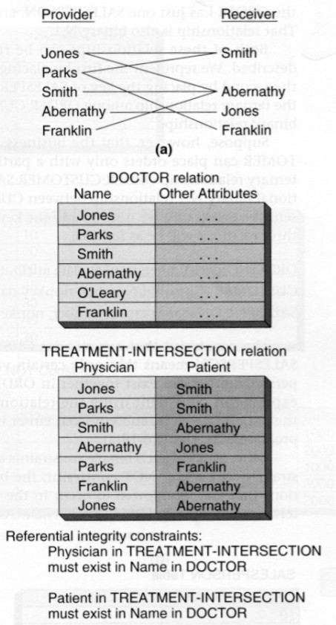
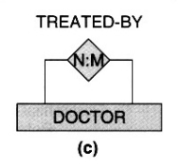
Tranforming a M:N Recursive Relationship Into a Relational Design

Slide 26
Case III : M:N Relationships
DOCTOR (DrName, other_attributes_of_Doc)
TREATMENT (Physician, Patient)
Referential Integrity Constraints: Physician in TREATMENT must exist in DrName in DOCTOR, and Patient in TREATMENT must exist in DrName in DOCTOR.

Slide 27
Transforming E-R Supertype Subtype Relationships - 1
Suppose CLIENT has attributes ClientNumber, ClientName and AmountDue)
  Suppose INDIVIDUALCLIENT has additional attributes Address and SocialSecurityNumber.
  Suppose PARTNERSHIPCLIENT has additional attributes ManagingPartnerName, Address, TaxIDNum
  Suppose CORPORATECLIENT has additional attributes ContactPerson, Phone, TaxIDNum

Slide 28
Transforming E-R Supertype Subtype Relationships - 2
CLIENT( ClientNumber, ClientName, AmountDue)
INDIVIDUALCLIENT( ClientNumber, Address, SocialSecurityNumber)
PARTNERSHIPCLIENT(ClientNumber, ManagingPartnerName, Address, TaxIDNum)
CORPORATECLIENT( ClientNumber, ContactPerson, Phone, TaxIDNum)

Slide 29
Rules for Transforming E-R Supertype Subtype Relationships
Create one relation for the supertype.
  Place in the relation the attributes of the supertype.
Create one relation for each subtype.
  Place in the relation the attributes of the subtype.
  Place in the relation the primary key of the supertype.

Slide 30
EMPLOYEE
TRUCK-ASSIGN
∈
TRUCK
0
1:1
ENGINEER
ENG-SKILL
SERVICE-PROVIDER
1:N
1:N
0
0
SERVICE
ENGINEER
CERTIFICATION
FEE
N:M
CLIENT-SERVICE
0
0
QUAL-ENGR
N:1
CLIENT
0
0
CERTIFICATION
1:N
REFERRED-BY

Slide 31
Relational Database Representation of the Engineering Service Company E-R Model
EMPLOYEE( empnum, other nonkey EMPLOYEE attributes.)
ENGINEER( empnum, engnum, other nonkey ENGINEER attributes ...)
TRUCK( truckidnum, other nonkey TRUCK attributes, empnum)
SERVICE( invoicenum, other nonkey SERVICE attributes, empnum)
CLIENT( clientnum, other nonkey CLIENT attributes, referredby)
SERVICE-CLIENT( invoicenum, clientnum, fee)
ENGINEER-CERTIFICATION(empnum, certificationname, other nonkey ENGINEER-CERTIFICATION attributes)
CERTIFICATION( certificationname, other nonkeyCERTIFICATION attributes)

